Slide 1
TESTING THE ACCURACY OF THE EXTRAPOLATION OF THE ADCP SOFTWARE
A beautiful morning/afternoon made possible by group 4
Matthijs Buijs, Valerie Demetriades, Sanne de Smet, Sjoerd Gnodde and Xinbai Xie

Slide 2
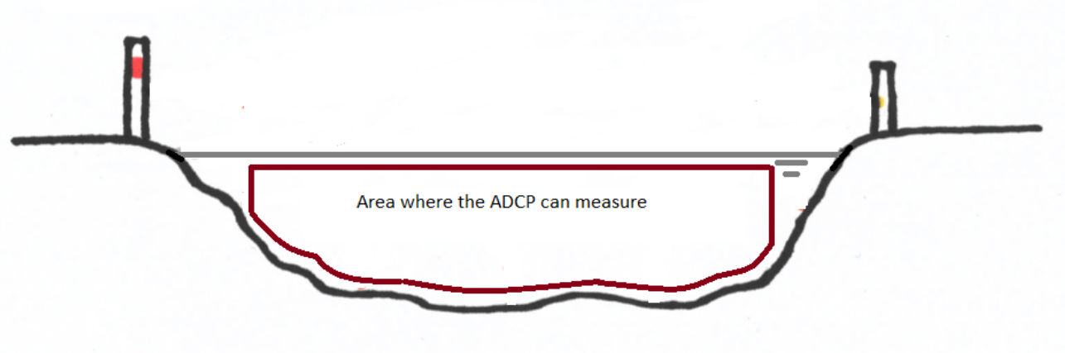
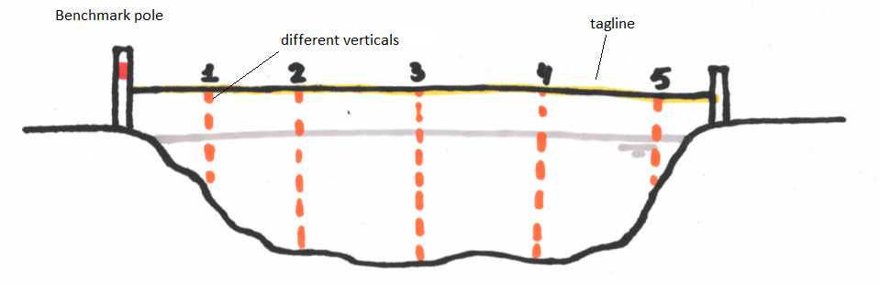
ADCP vs ADV
ADCP
ADV
Uses the Doppler effect to determine velocity
Determines the velocity over the depth profile and the transection when the boat is dragged
Cannot measure too close to the bottom, surface and the sides
Works similar to ADCP
Can measure on a single point

Slide 3
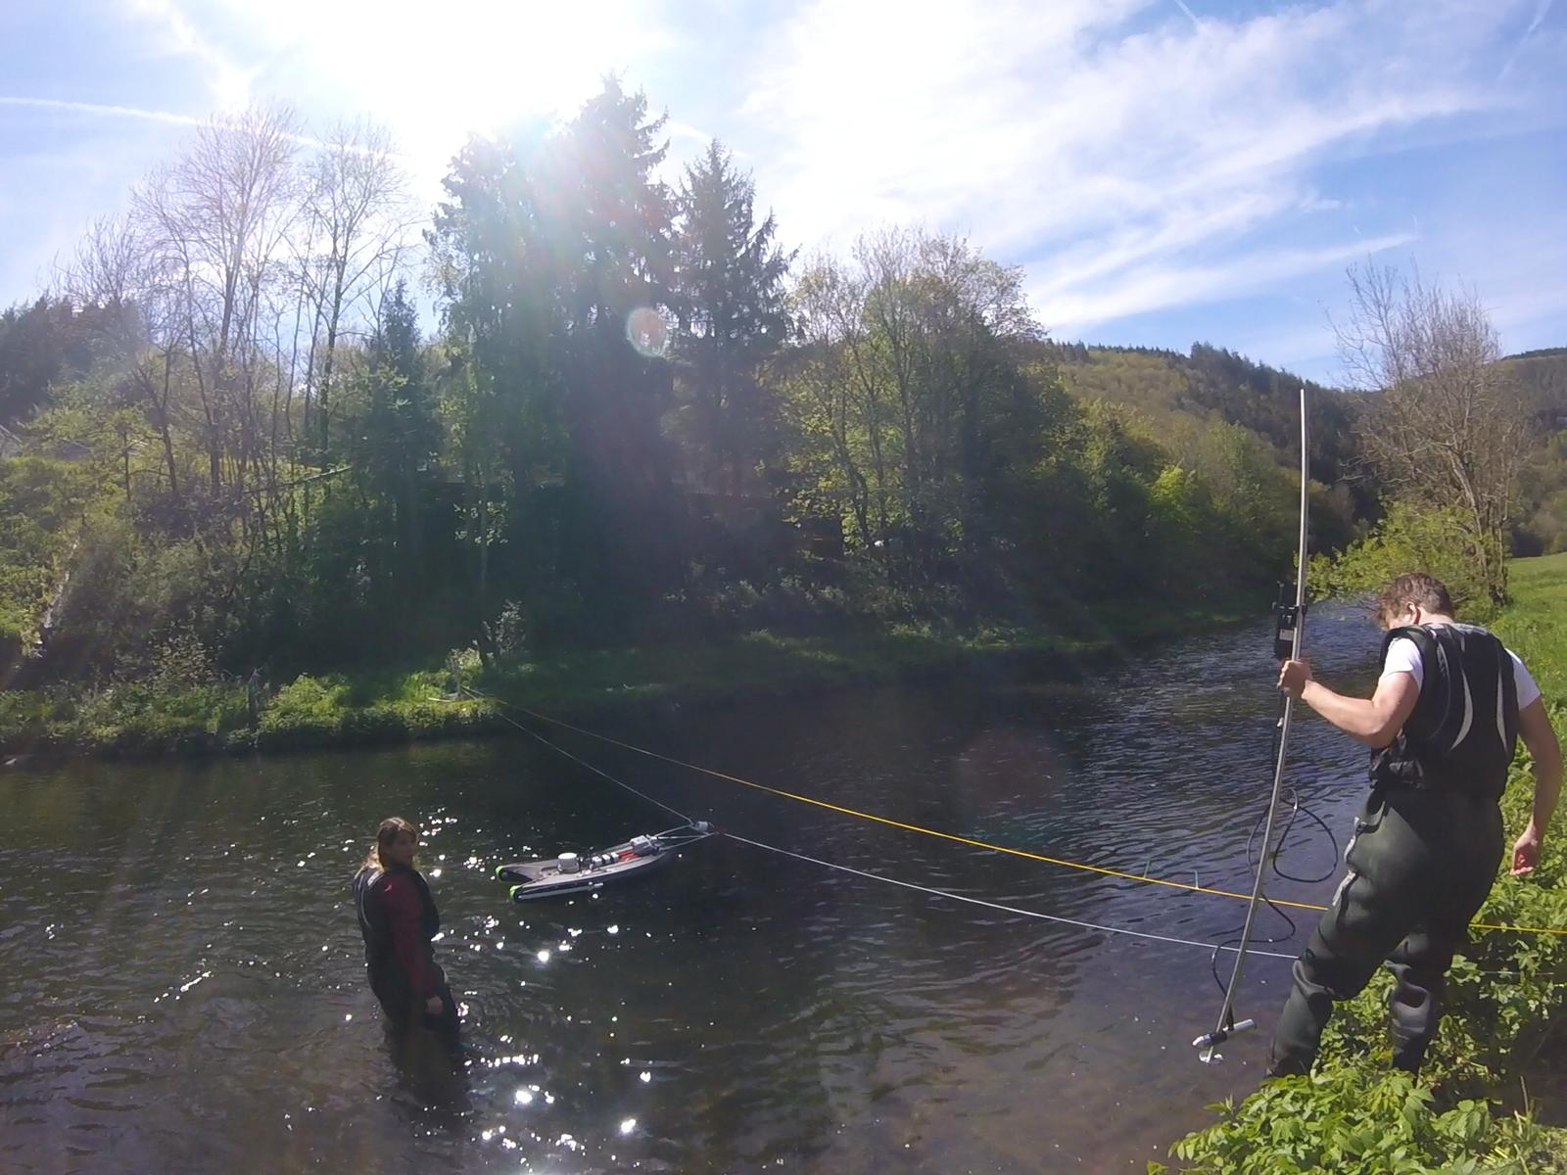
ADV
ADCP

Slide 4
Research question
How does the extrapolation of the streamflow by the ADCP software compare to the ADV measurements?
Which extrapolation method of the two different ADCPs is more accurate?

Slide 5
What are you going to do?
Measure the streamflow with the two different ADCPs
Take many point measurements with the ADV:
In the middle of the stream to check whether they are comparable to that of the ADCP
Extra measurements at the sides in the blanking zones of the ADCP

